Slide 1
(2227:TT)
Yulon Nissan Motor Co., Ltd.
May. 18th, 2016

Slide 2
Safe Harbor Notice
This document is provided by Yulon-Nissan Co., Ltd. (the "Company"). Except for the numbers and information included in the Company's financial statements, the information contained in this document has not been audited or reviewed by any accountant or independent expert. The Company makes no express or implied representations or warranties as to the fairness, accuracy, completeness, or correctness of such information or opinions. This document is provided as of the date herein and will not be updated to reflect any changes hereafter. The Company, its affiliates and their representatives do not accept any responsibility or liability for any damage caused by their negligence or any other reasons, nor do they accept responsibility or liability for any loss or damages arising from the use of this document or the information contained herein or anything related to this document.
This document may contain future prospection statements, including but not limited to all statements that address activities, events or developments that the Company expects or anticipates to take place in the future based on the projections of the Company toward the future, and various factors and uncertainness beyond the Company's control. Therefore, the actual results may differ materially from those contained in the forward-looking statements.
This document is not and cannot be construed as an offer to purchase or sell securities or other financial instruments or solicitation of an offer.
The copy right of this document belongs to the company and its affiliates. This document may not be directly or indirectly reproduced, redistributed or forwarded to any other person and may not be published in whole or in part for any purpose.

Slide 3
AGENDA
1
  Company Profile
2
  Operation Briefing
3
  Core Strategy
4
  Cross-strait Market Forecast

Slide 4
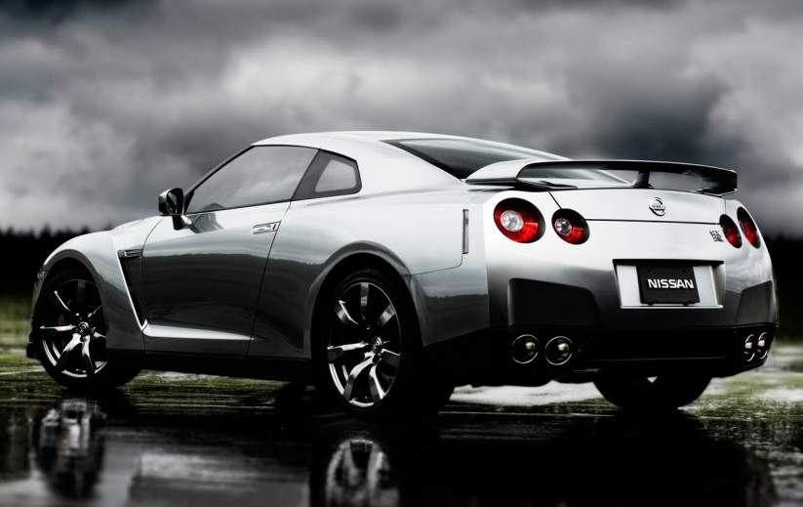
1
Company Profile

Slide 5
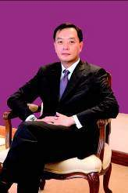
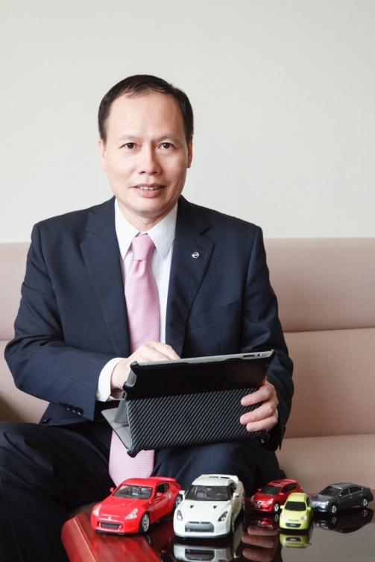
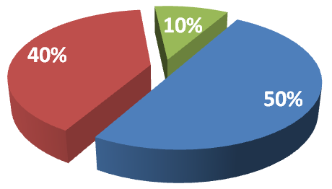
Yulon-Nissan Motor profile
Company name：Yulon-Nissan Motor Co., Ltd.
Establishment date：Oct. 22nd , 2003
Chairman：Kenneth, K.T. Yen
President：Steve, W.R. Tsay
Capital：3 billion NTD
Shareholder structure：
Others
Nissan Motor
Yulon Motor

Slide 6
營運範疇
Operation Scope
創新 ‧ 速度 ‧ 團隊
Full value chain operation of Nissan and Infiniti brand in Taiwan excluding manufacturing process
Joint cooperation with DongFeng Motor for PRC market development
1
Domestic Business
Full value chain operation of Nissan and Infiniti brand in Taiwan excluding manufacturing process
40%
廣州風神汽車有限公司 (Plant)
（annual capacity 1250K units）
2
Overseas Investment
16.55%
風神襄陽汽車有限公司 (Plant)
（annual capacity 250K units）
義展海外投資股份有限公司
33.12%
風神汽車有限公司 (Sales Co.)
45%
深圳聯友科技有限公司（IT）
義華大陸投資股份有限公司
49%
東風裕隆舊車置換有限公司
(Used Car）

Slide 7
Corporate Vision
Become the benchmark company of
“Product Innovation” & “Service Innovation”
in the Cross-strait Auto Industry

Slide 8
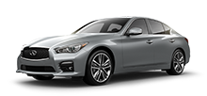
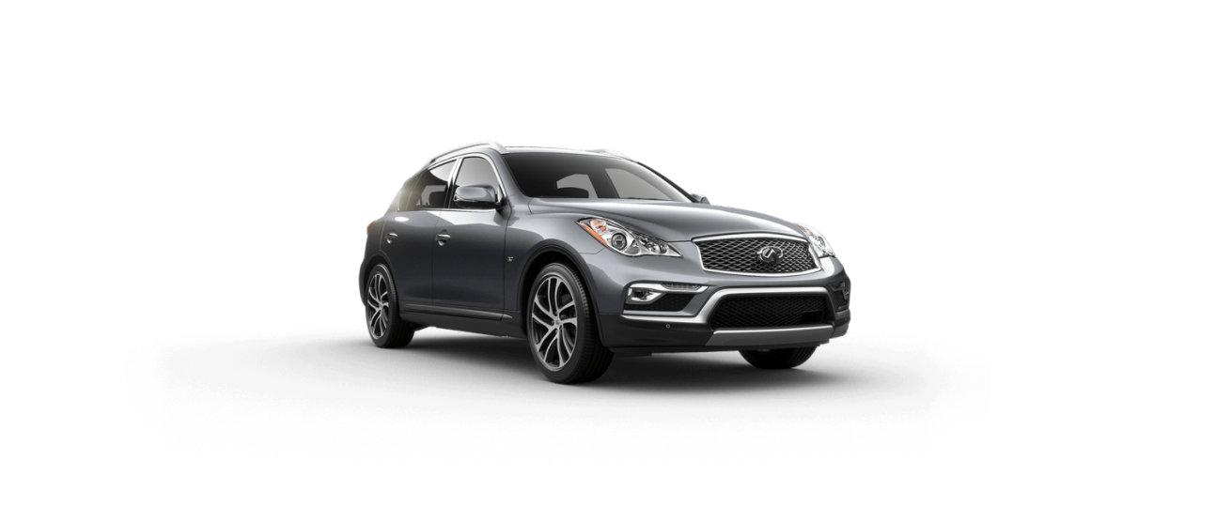
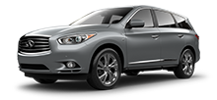
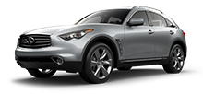
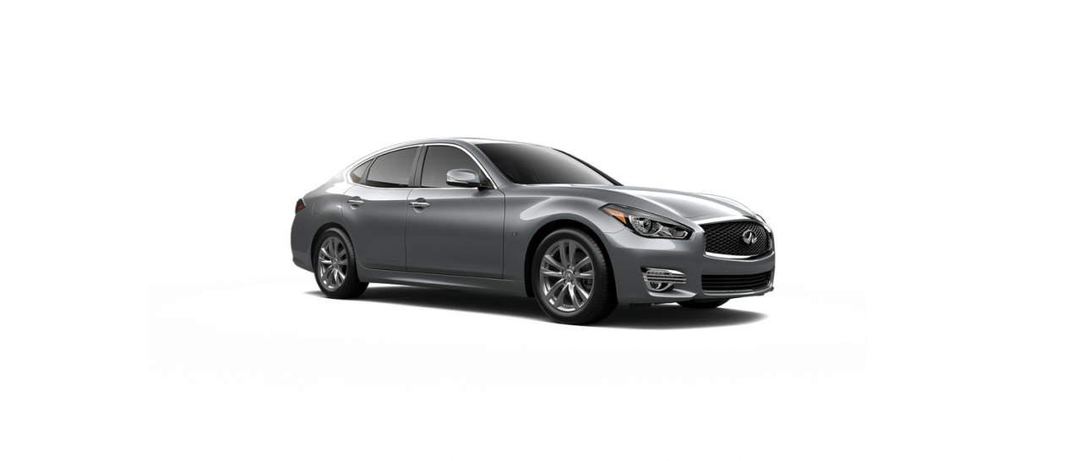
INFINITI- Imported Luxury Models
Q 50
QX 50
QX 60
Q 70
QX 70

Slide 9
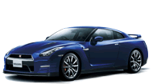
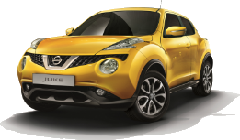
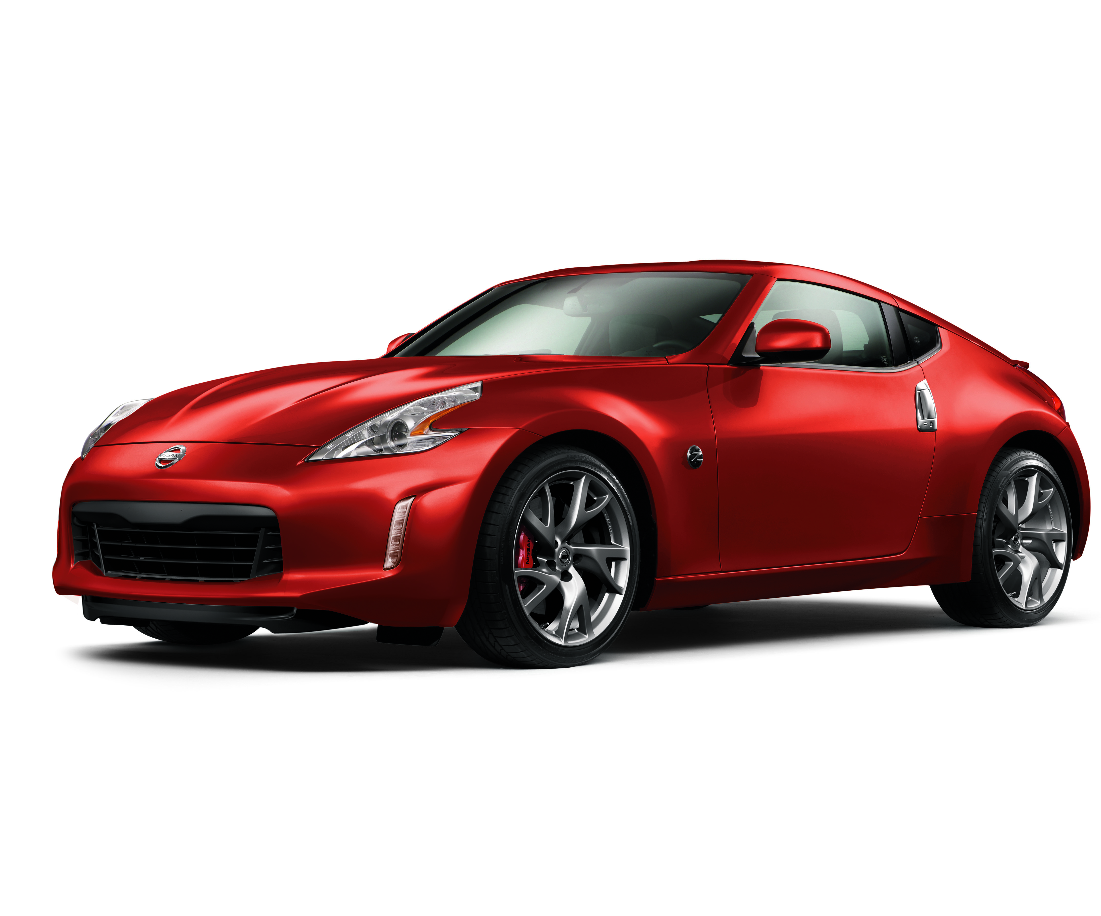
NISSAN- Imported Models
GT-R
JUKE
370 Z

Slide 10
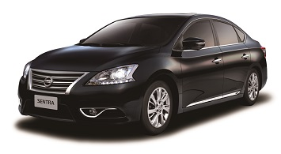
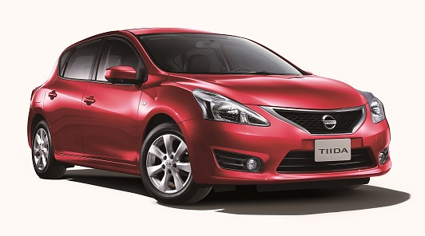
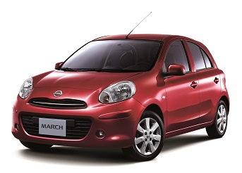
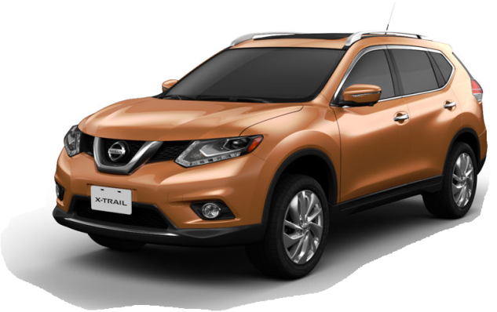
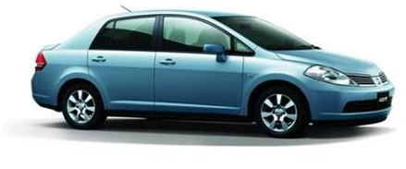
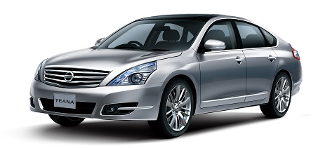
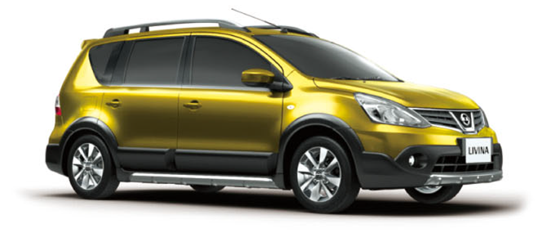
NISSAN- Domestic Models
SUPER SENTRA
BIG TIIDA
NEW MARCH
X-TRAIL
TIIDA
TEANA
ALL NEW LIVINA

Slide 11
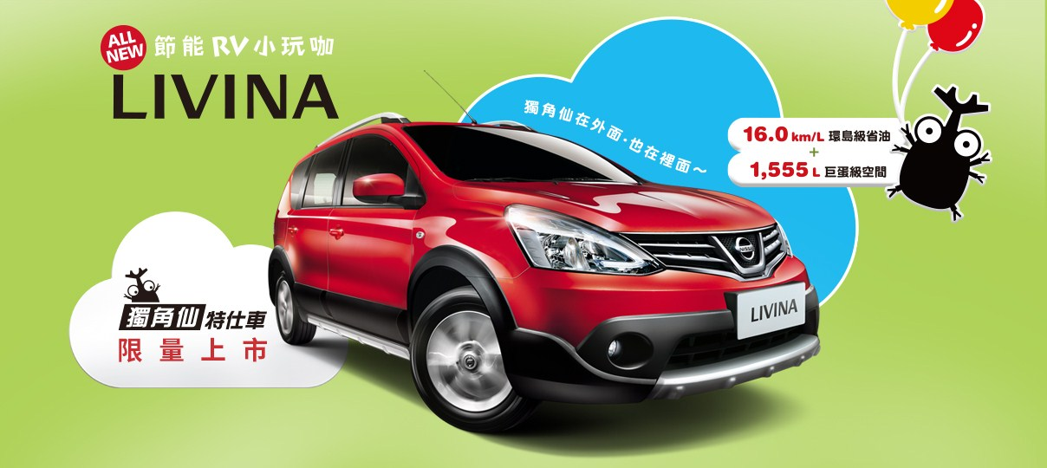
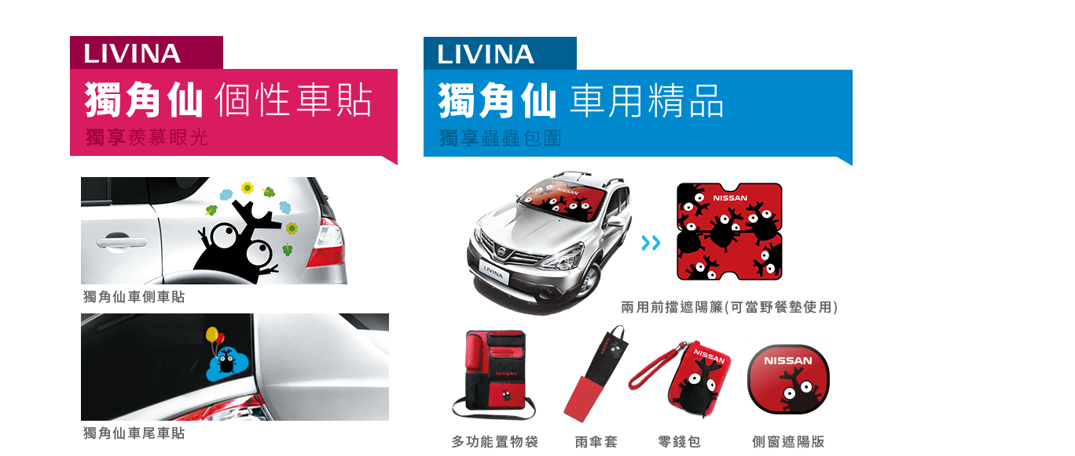
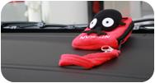
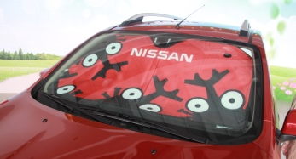
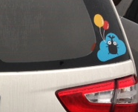
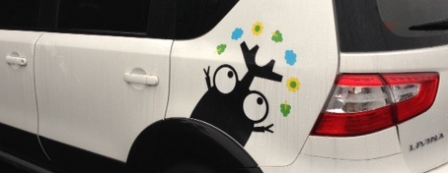
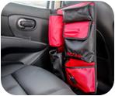
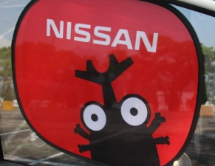
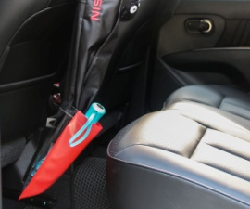
NISSAN -New Model Campaign

Slide 12
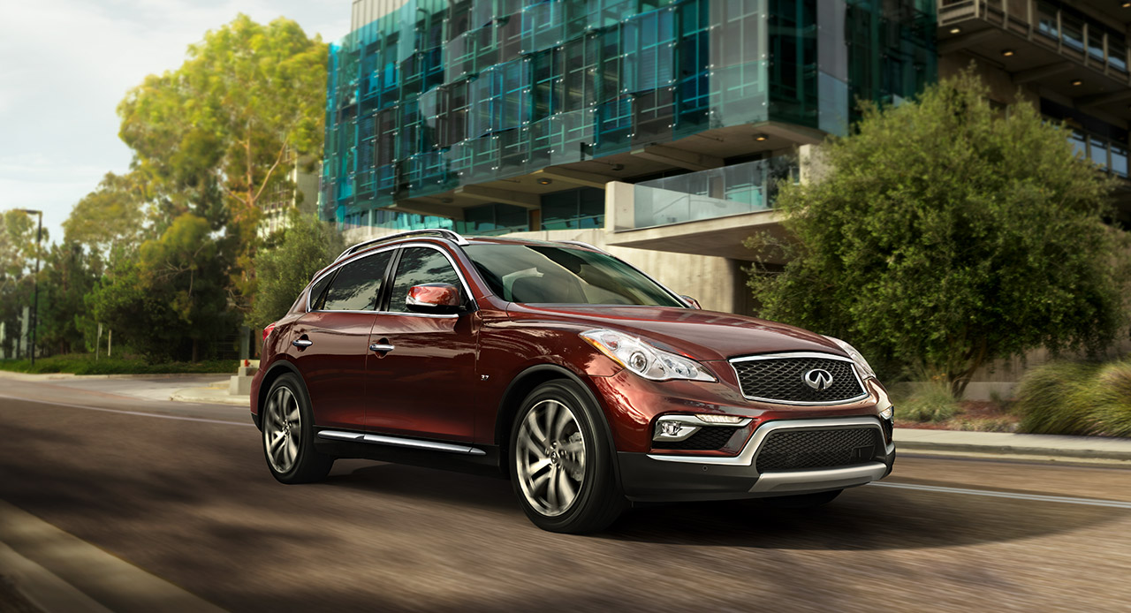
INFINITI -New Model Campaign
THE NEW QX50 精品跑旅
以 獨 具 匠 心 ， 打 造 優 雅 精 緻 駕 乘 享 受

Slide 13
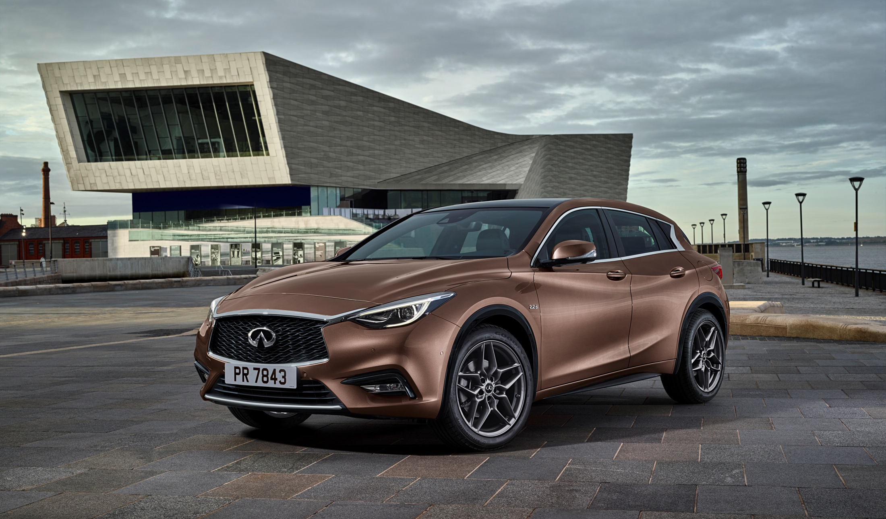
INFINITI –Upcoming New Model
INFINITI Q30 都會跑旅．豪華掀背

Slide 14
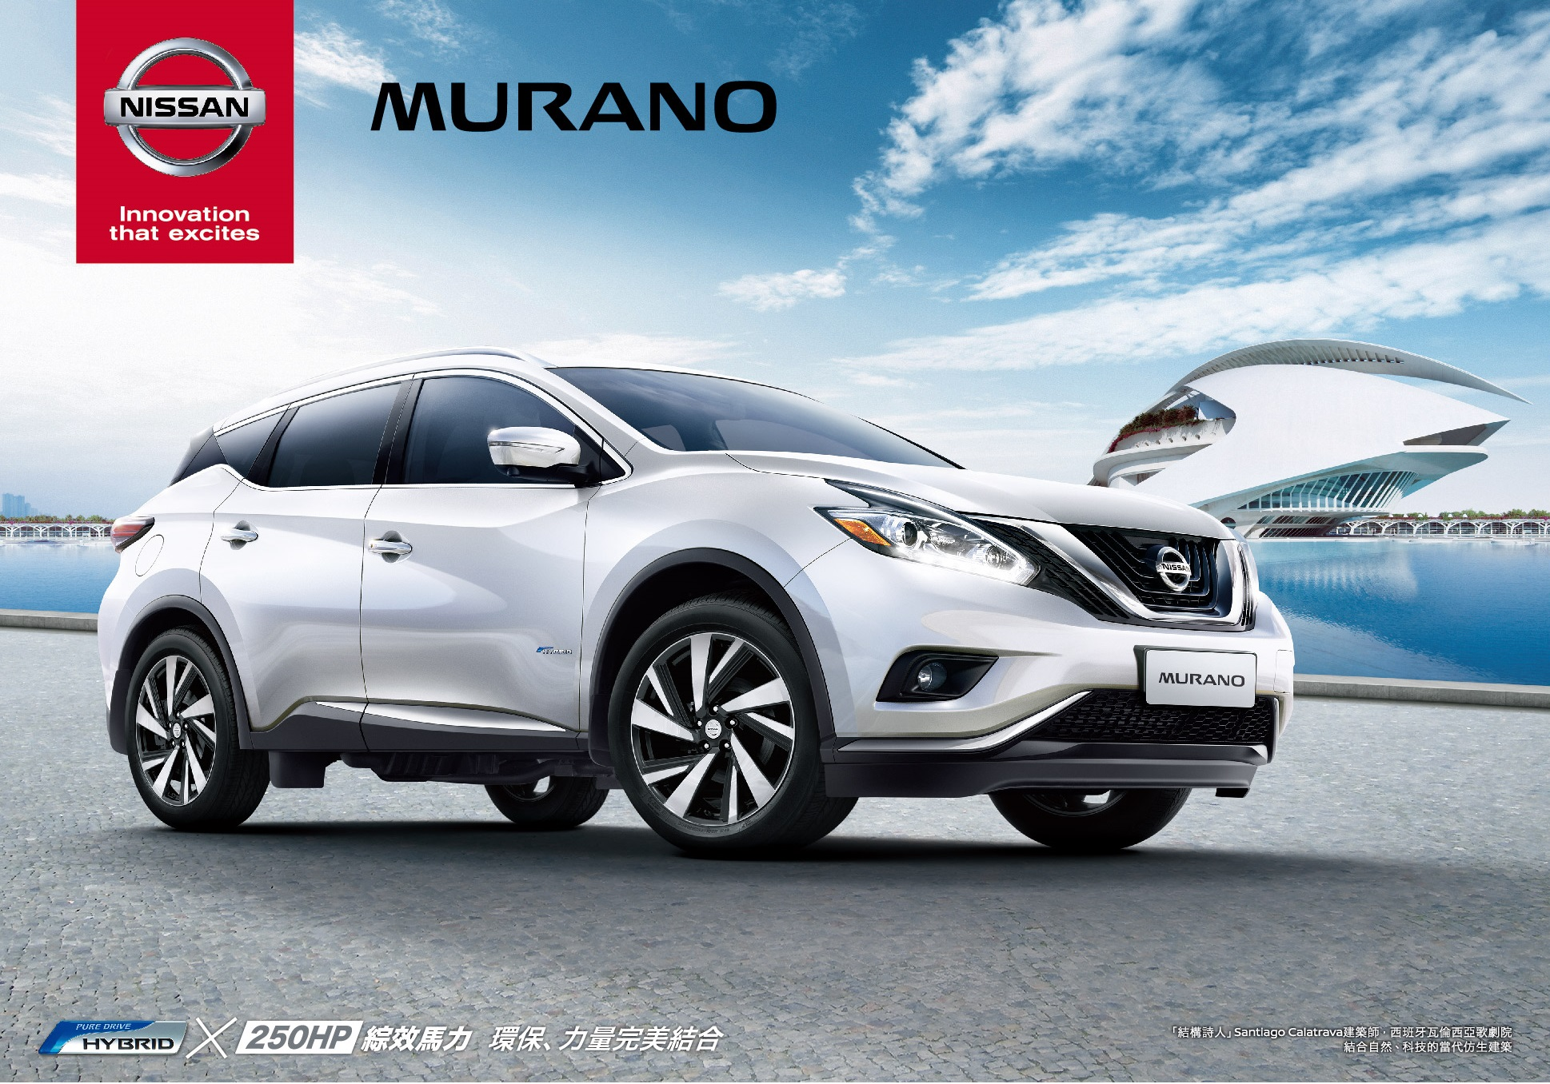
NISSAN –Upcoming New Model

Slide 15
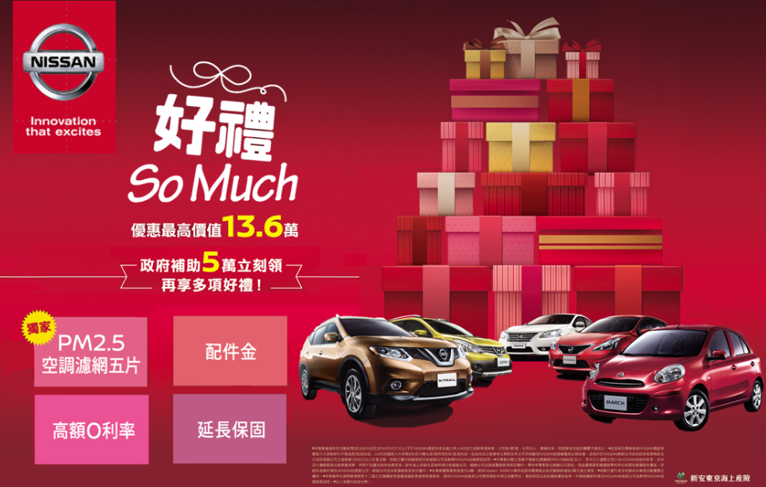
NISSAN-The Latest Marketing Program

Slide 16
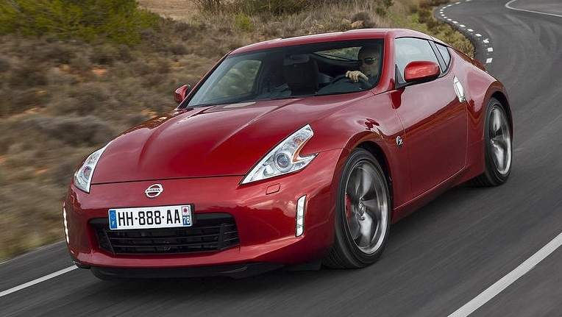
2
Operation Briefing

Slide 17
Consolidated Statements of Comprehensive Income

Slide 18
Consolidated Balance Sheets

Slide 19
Market Share Status
Year 2016 Jan.~Apr. Market Share Chart
10.5%
Nissan Market share from Jan. to Apr. this year is 10.5%.

Slide 20
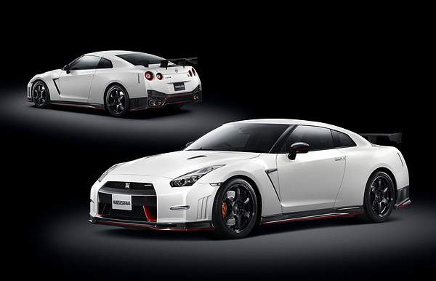
3
Core Strategy

Slide 21

6-Year Midterm Plan (2011~2016)
Power
8%
8%
Brand & sales power
Global market share by FY16
Sustainable COP
Brand Power
Sales Power
Enhancing Quality
Zero-Emission Leadership
Business Expansion
Cost Leadership
Pillar 1
Pillar 2
Pillar 3
Pillar 4
Pillar 5
Pillar 6

Slide 22





Operation Strategy
Operating Profit & Market Share
Product Strategy
Marketing Strategy
Customer Satisfaction Strategy
Profit Enhancement Strategy
HR strategy
Smart-Decision Support System(S-DSS)

Slide 23
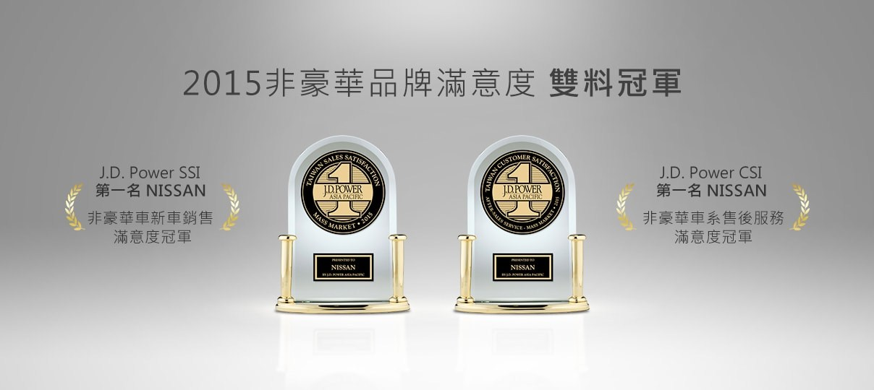
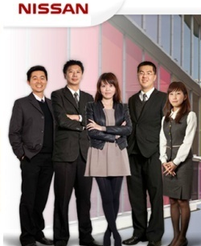

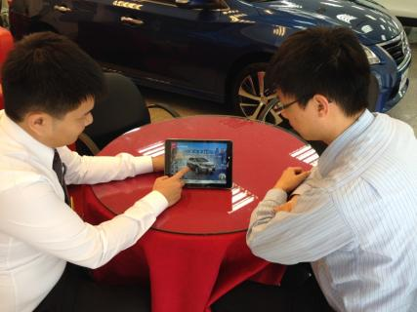
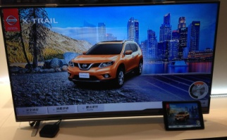

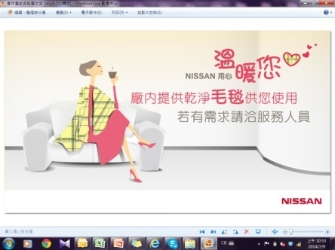
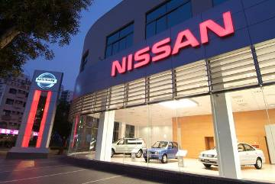
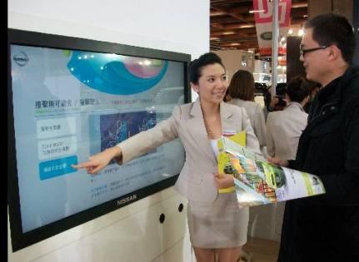
Strengthening Service Competitiveness
Elite sales
Test driving at your home
Service triangle
NISSAN PAD
業代
接待
技師
Customer resting area upgrade
Female customer treatments
Smart-Dealer Management System
Interactive touch panel system

Slide 24

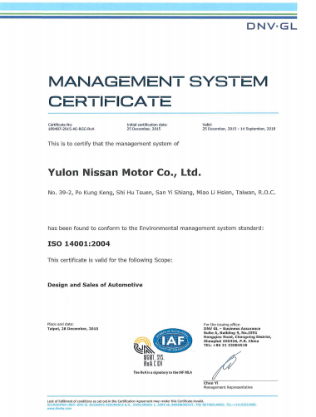


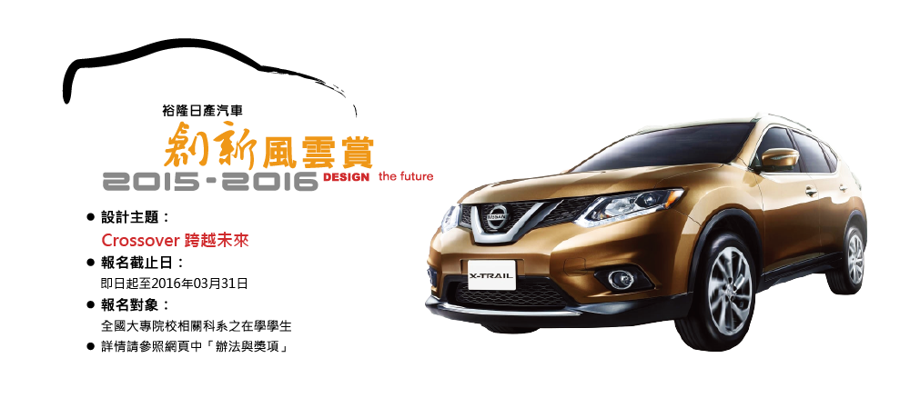
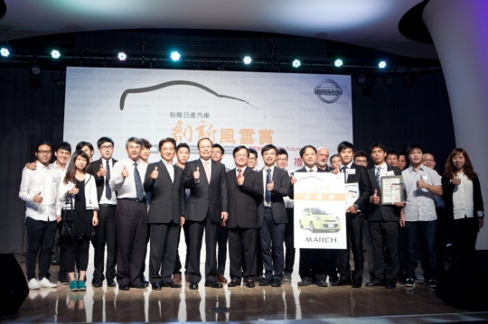

Corporate Social Responsibility
Environmental Education from Childhood
CSR POLICY
ISO-14001
Certification
Achieve Customer Satisfaction
Create prosperity for the corporation
Contribute to the welfare of society
CSR POLICY
Automobile Design Contest for College Students

Slide 25
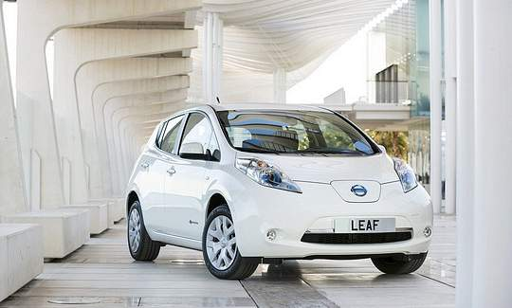
4
Cross-strait Market Forecast

Slide 26
Taiwan automobile market status
TIV volume (unit: 10K)
Growth rate (%)
(41.0)
※The heavy trucks are excluded in TIV calculation
（Jan. ~ Apr.）
Because of the sluggish global economy, the growth of 2016 Taiwan vehicle market is estimated conservatively. Even though, the low oil prices and the implementation of commodity tax subsidy policy bring about 2016 Taiwan total industry volume(TIV) to the same level as previous year. Estimated TIV will be 410K units in 2016.
Up to the end of Apr., TIV is 139 K units which is almost identical to the same period in the last year.

Slide 27


PRC automobile market status
TIV volume
(unit: 10K)
Growth rate (%)
※sales volume including passenger and commercial vehicles
（Jan.~Mar.）
Dongfeng Nissan Passenger Vehicle Company –
Sales performance
1,080 K units
1,026 K units
5 %
Jan.~Mar. ： 215 K units
Increased by 13.4% over the same period in the last year
2015
2016

Slide 28
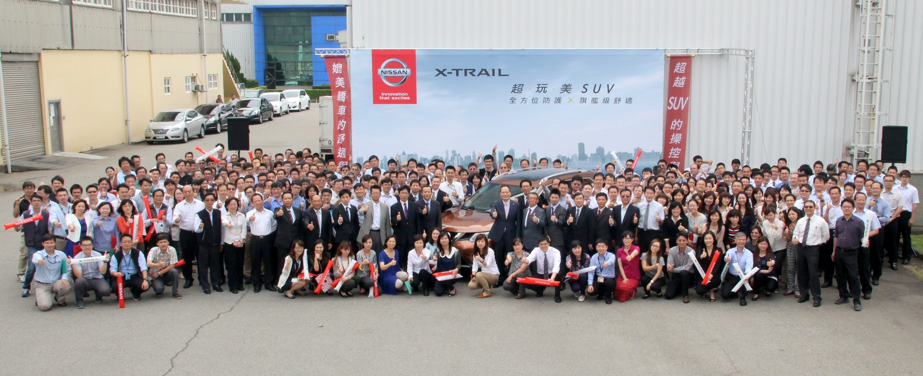

THANK YOU FOR YOUR ATTENTION

